Slide 1
Separating Solids
Year 7 Science

Slide 2
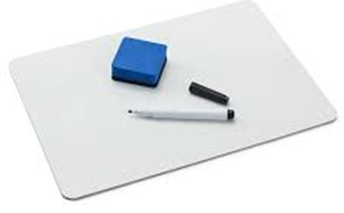
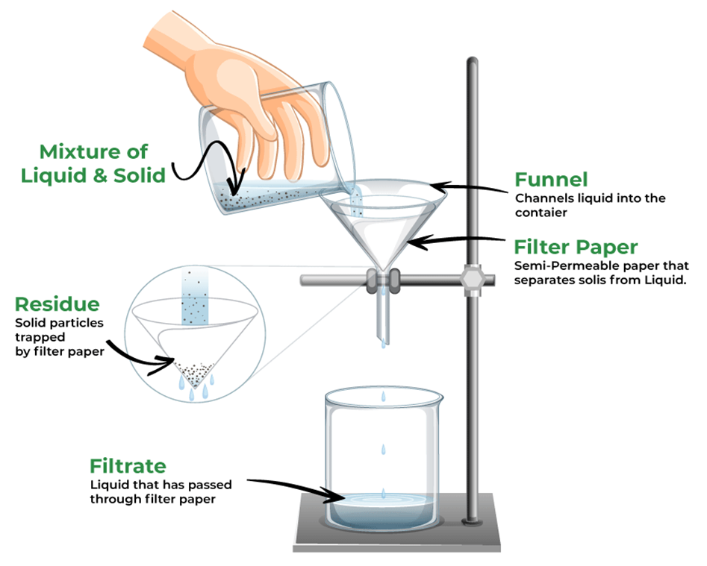
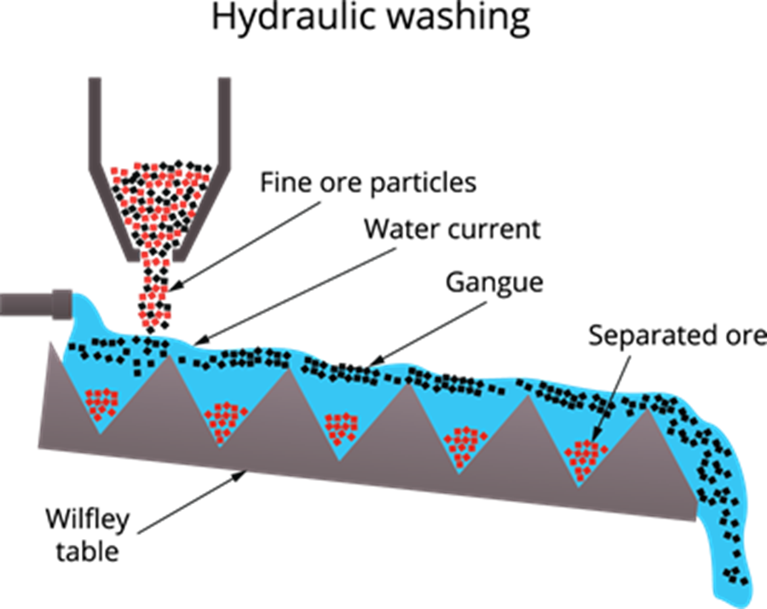
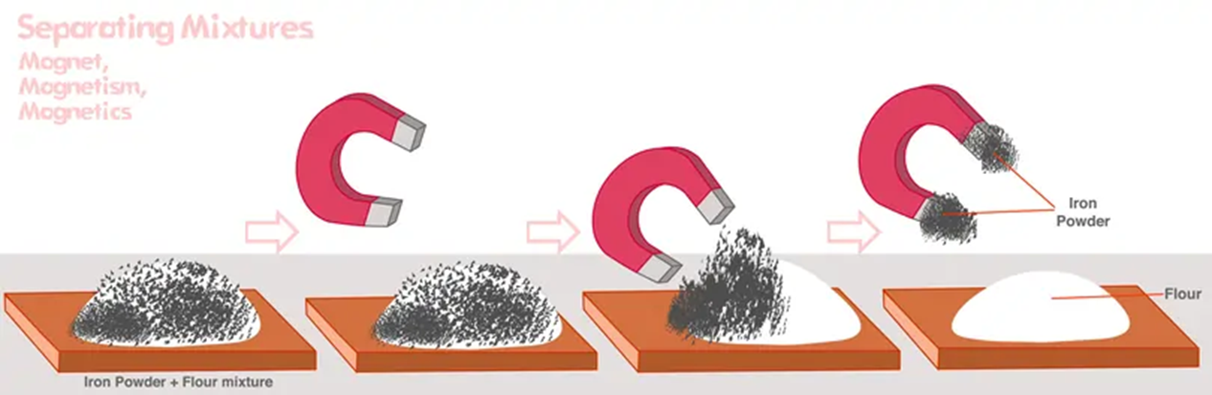
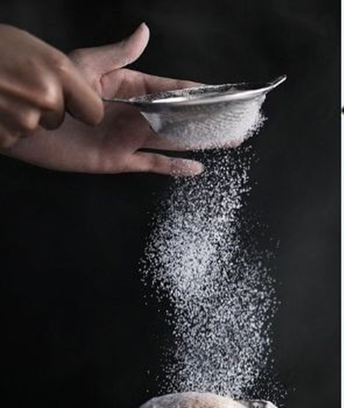
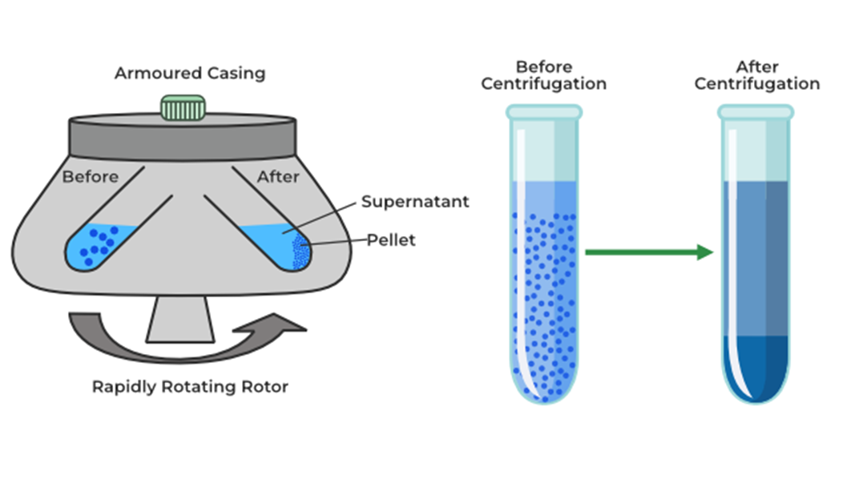
Review:
Which separation technique is shown?
List as many physical properties as you can

Slide 3
Learning Intentions
Mixtures, including solutions, contain a combination of pure substances that can be separated using a range of techniques.

Slide 4
Success criteria
Investigate ways of separating solids, based on their physical properties.

Slide 5
Investigation: Separating Solids
Separate a mixture of sand, gravel, iron filings and salt.
Plan first: show your plan to me before starting.

Slide 6
Safety:
Step 1:
Step 2:
Step 3

Slide 7
Success criteria
Investigate ways of separating solids, based on their physical properties.

